Slide 1

t-SNE: A Technique for Dimensionality Reduction
Brody Kellish, Joe Timko, Nicholas von Turkovich
Presentation based on the work of Laurens van der Maaten and Geoffrey Hinton (https://lvdmaaten.github.io/publications/papers/JMLR_2008.pdf)

Slide 2
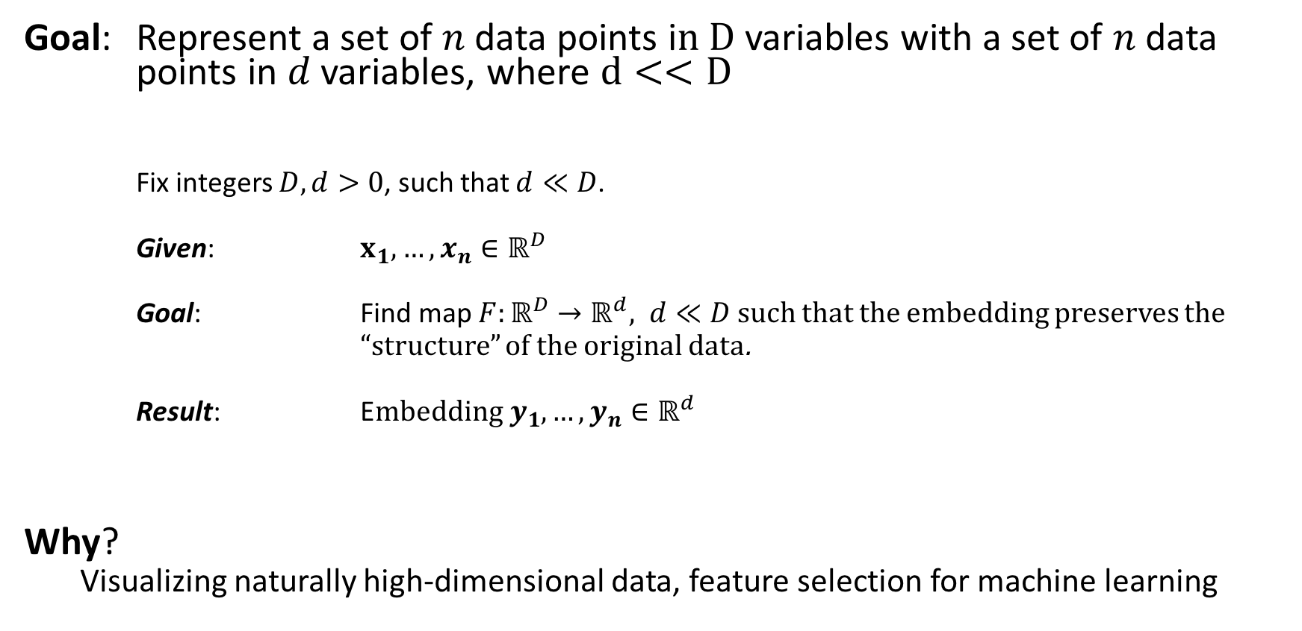
The Problem: Dimensionality Reduction
Goal: Represent a set of $n$ data points i$n D$ variables with a set of $n$ data points in $d$ variables, where $d<<D$
Fix integers $D, d>0$, such that $d≪D$.
Given: $x_{1},…, x_{n}∈ℝ^{D}$
Goal: Find map $F:ℝ^{D}→ℝ^{d}, d≪D$ such that the embedding preserves the
“structure” of the original data.
Result: E$mbedding y_{1},…,y_{n}∈ℝ^{d}$
Why?
Visualizing naturally high-dimensional data, feature selection for machine learning
Notes:
Fix P and N to D and d

Slide 3
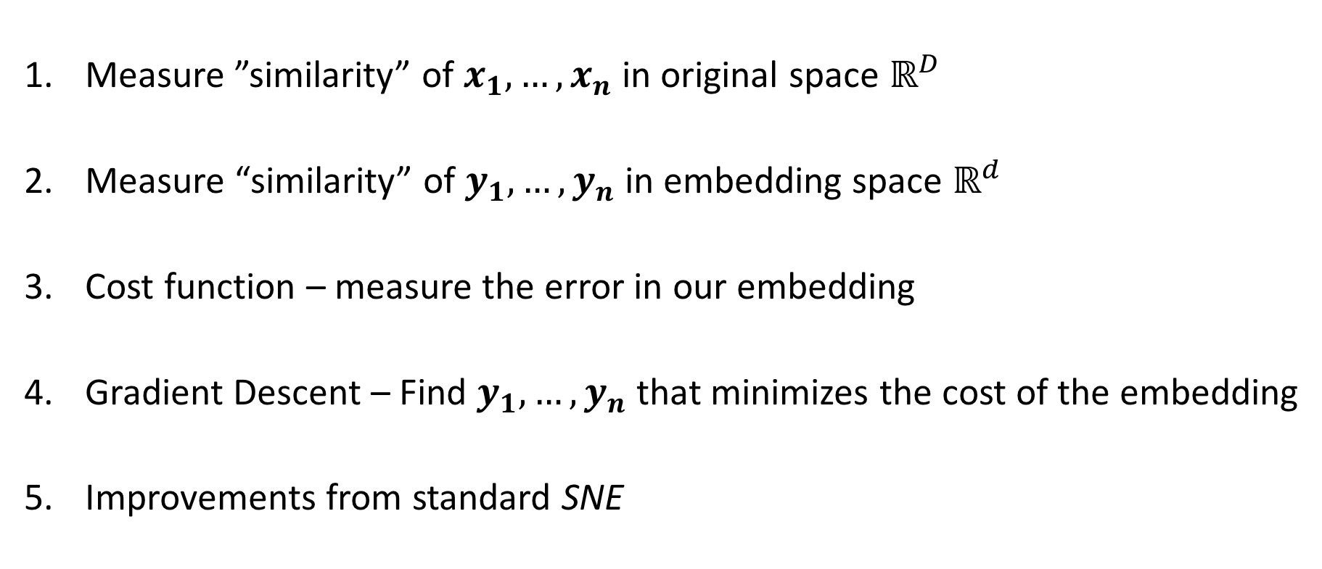
Lesson Overview
Measure ”similarity” of $x_{1},…,x_{n}$ in original space $ℝ^{D}$
Measure “similarity” of $y_{1},…,y_{n}$ in embedding space $ℝ^{d}$
Cost function – measure the error in our embedding
Gradient Descent – Find $y_{1},…,y_{n}$ that minimizes the cost of the embedding
Improvements from standard SNE

Slide 4

Similarity in $ℝ^{D}$
$p_{j|i}=$ “neighborliness” of $x_{j}$ g$iven x_{i}$
$=\frac{exp\left({\left(−{\left|\left|x_{i}−x_{j}\right|\right|}^{2}\right)}/{\left(2σ_{i}^{2}\right)}\right)}{\sum_{k≠i}{exp⁡\left({\left(−{\left|\left|x_{i}−x_{k}\right|\right|}^{2}\right)}/{\left(2σ_{i}^{2}\right)}\right)}}$
Define $p_{ij}= \frac{p_{i|j} + p_{j|i}}{2n}=p_{ji}$
Question
How do we choose a good $σ_{i}$?
Notes:
Use analogy to describe more intuitively what similarity means especially depending on your location within the point cloud
How this works:
Iterate over values of sigma
Sigma induces a change in the values of p_j|j
Iterate over different distributions or values for sigma until the entropy value is reached
This is a way of determining distributions that biases the algorithm to care more about preserving local structure
Symmetric pij to make the gradient easier to compute

Slide 5
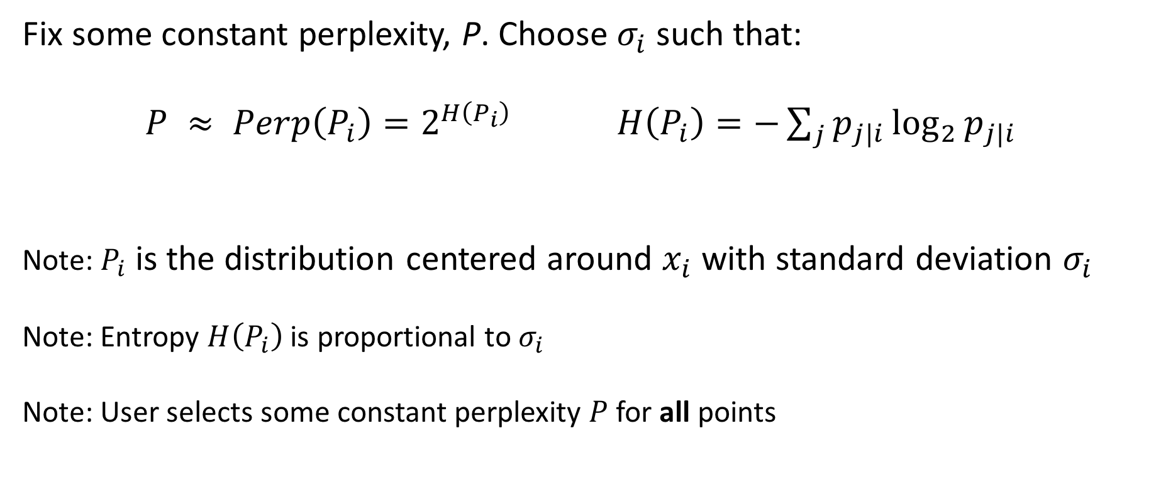
Finding $σ_{i}$?
Fix some constant perplexity, P. Choose $σ_{i}$ such that:
$P ≈ Perp\left(P_{i}\right)=2^{H\left(P_{i}\right)}$ $H\left(P_{i}\right)=−\sum_{j}{p_{j|i}\log_{2}{p_{j|i}} }$
Note: $P_{i}$ is the distribution centered around $x_{i}$ with standard deviation $σ_{i}$
Note: Entropy $H\left(P_{i}\right)$ is proportional to $σ_{i}$
Note: User selects some constant perplexity $P$for all points
Notes:
Define the sense of neighborliness for two different locations highly dense or sparse. In a city your neighbors might be the people in your apartment building or even on specifically your floor in the building if it is a large building. Perform a binary search on values of sigma to get within an acceptable range of Perplexity. Due to the log, points farther away contribute more to the Shannon Entropy in the exponent. Therefore the perplexity can be fulfilled by having several points very far away from x_i in a sparse neighborhood all contributing highly to the entropy, or by many points in a densely populated space each contributing a small amount to the entropy. Intuitively this makes sense, as more bits are required to communicate the information in highly differentiated data and vice versa.
*Draw two different Gaussians around different neighborhoods, explain how this gives a localized sense of what points might be considered the local structure surrounding x_i*

Slide 6
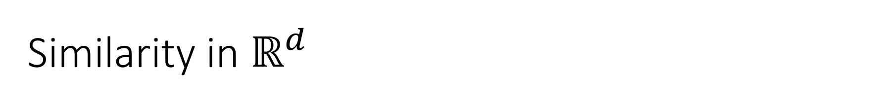

Similarity in $ℝ^{d}$
$q_{ij}=$ “neighborliness” between $y_{j}$ a$nd y_{i}$ $= \frac{{\left(1+{\left|\left|y_{i}−y_{j}\right|\right|}^{2}\right)}^{−1}}{\sum_{k≠l}{{\left(1+{\left|\left|y_{k}−y_{l}\right|\right|}^{2}\right)}^{−1}}}$
Note: $q_{ij}$ is defined using a Student-t distribution, as opposed to a Gaussian distribution
Notes:
As you go from high dimension to low dimension, unless there were redundant variables/feature of your data points, some distances will be distorted
In the case of TSNE, since local structure is preserved and prioritized, larger distances/more global structures can be distorted, specifically enlarged
What that means is points that are not close in high dimensional space may be forced to be modeled farther from each other in low dimensions (recall the triangle of points demonstration and show that the p and q values create an attractive force on the farthest points in the mapped dimension)
To compensate for this reality, the paper writers used a student t-distribution with 1 degree of freedom to reflect/describe the increased probability of points existing far away from each other in the smaller dimension. Since the distribution has fatter tails than the gaussian, the p value (say 0.05) on the blue line represents a point moderately distant from the rest. In the mapped dimension, to get the q value that would incur no difference in the gradient, the point must be even more distant. This prevents the issue of crowding

Slide 7
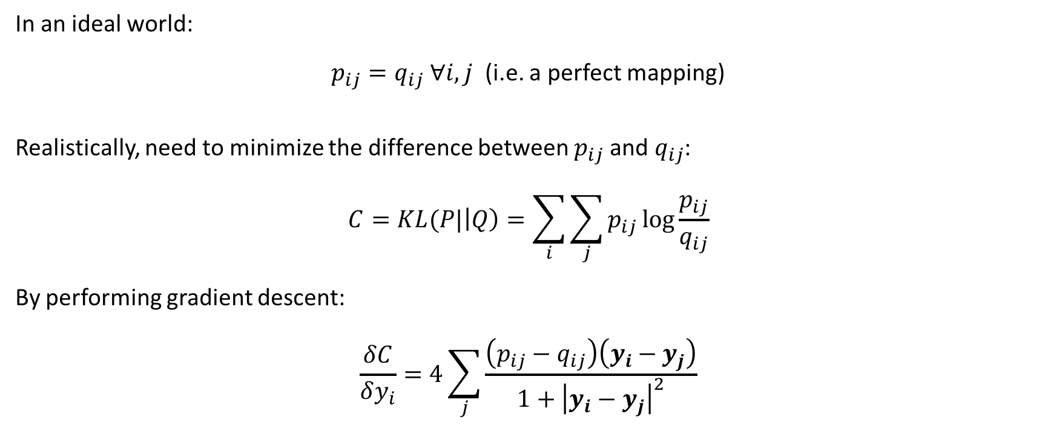
Cost of the Mapping
In an ideal world:
$p_{ij}=q_{ij} ∀i, j$ (i.e. a perfect mapping)
Realistically, need to minimize the difference between $p_{ij}$ and $q_{ij}$:
$$C=KL(P|\left|Q\right)=\sum_{i}{\sum_{j}{p_{ij}\log{\frac{p_{ij}}{q_{ij}}}}}$$
By performing gradient descent:
$$\frac{δC}{δy_{i}}=4\sum_{j}{\frac{\left(p_{ij}−q_{ij}\right)\left(y_{i}−y_{j}\right)}{1+{\left|y_{i}−y_{j}\right|}^{2}}}$$
Notes:
Ideally, if the probability distributions between pairs of points are the same between the high dimensional space and the low dimensional mapping, then they’re relative distances from each other are also equal. However, when embedding data, most of the time this does not happen and distances get distorted. Recall a triangle of points in the 2 plane forced onto a 1 dimensional plane.
Therefore, need to assign a metric or way of judging how bad the current embedding is. Note the C equation. This computes the sum of all mapping errors between the original data set and the mapped points. Note that the equation has a very specific idea of what constitutes an erroneous mapping of points. It assigns very high degree of error to a pair of points that are modeled as “close neighbors” in high d but are not close in low dimensions. Vice versa, being modeled as close in low dimension but far away in high dimension does not introduce much error.
Gradient descent is a computational method used to iteratively reach a system with lower value of some stated function, in this case cost. It is analagous to a ball roll down the hill to reach a state of lower potential energy. In this case, our potential energy is C (cost) or the overall mistake in our mapping. The gradient descent will wiggle each of the mapping points in the direction that specifies a negative dC/dy in order to maximally reduce the cost function with respect to that point. Doing that repeatedly for each point until the overall mapping has reached a minimum state of cost.

Slide 8
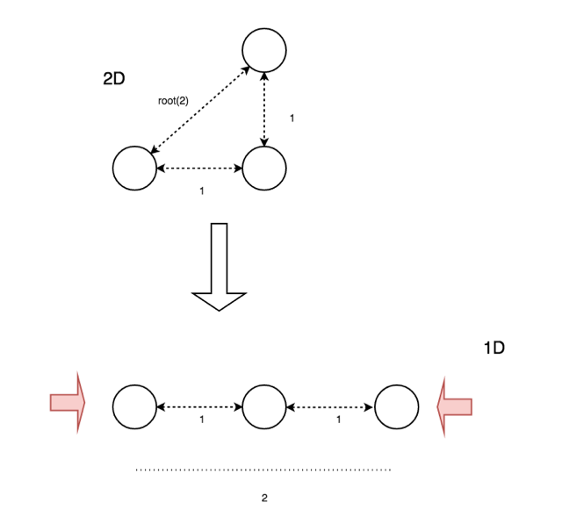
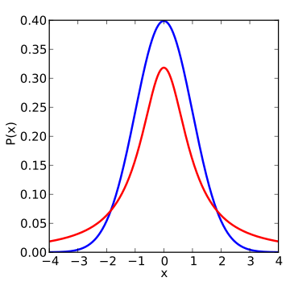
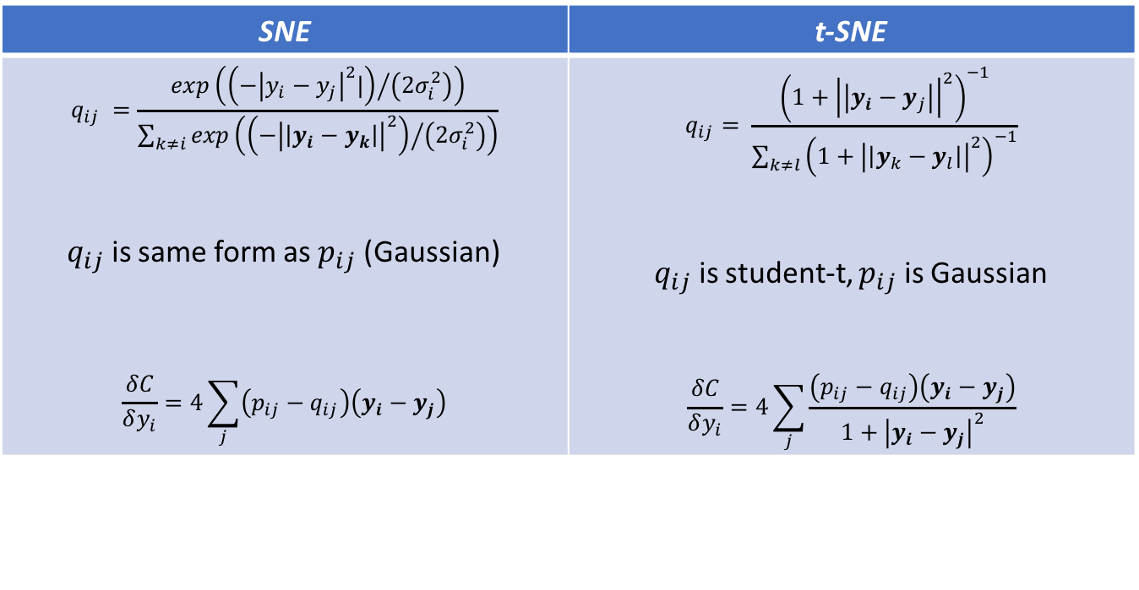
Putting the “t” in t-SNE
SNE | t-SNE
$$q_{ij} =\frac{exp\left({\left(−{\left|y_{i}−y_{j}\right|}^{2}|\right)}/{\left(2σ_{i}^{2}\right)}\right)}{\sum_{k≠i}{exp⁡\left({\left(−{\left|\left|y_{i}−y_{k}\right|\right|}^{2}\right)}/{\left(2σ_{i}^{2}\right)}\right)}}$$ $q_{ij}$ is same form as $p_{ij}$ (Gaussian) $$\frac{δC}{δy_{i}}=4\sum_{j}{\left(p_{ij}−q_{ij}\right)\left(y_{i}−y_{j}\right)}$$ | $$q_{ij}= \frac{{\left(1+{\left|\left|y_{i}−y_{j}\right|\right|}^{2}\right)}^{−1}}{\sum_{k≠l}{{\left(1+{\left|\left|y_{k}−y_{l}\right|\right|}^{2}\right)}^{−1}}}$$ $q_{ij}$ is student-t, $p_{ij}$ is Gaussian $$\frac{δC}{δy_{i}}=4\sum_{j}{\frac{\left(p_{ij}−q_{ij}\right)\left(y_{i}−y_{j}\right)}{1+{\left|y_{i}−y_{j}\right|}^{2}}}$$
Figure 1: Student t-distribution with 1 degree of freedom
(https://en.wikipedia.org/wiki/Student's_t-distribution#/media/File:T_distribution_1df_enhanced.svg)

Slide 9
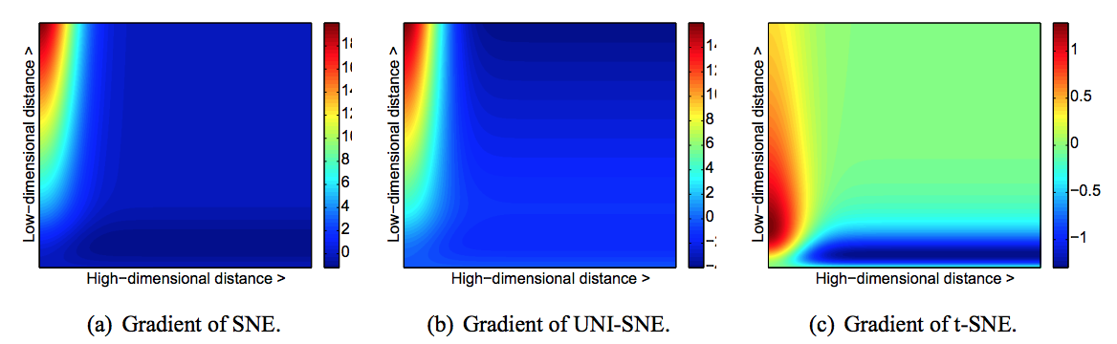
Visualizing the Gradient
Figure 2: Visualization of Cost Function Gradients for Two Points (https://lvdmaaten.github.io/publications/papers/JMLR_2008.pdf)

Slide 10
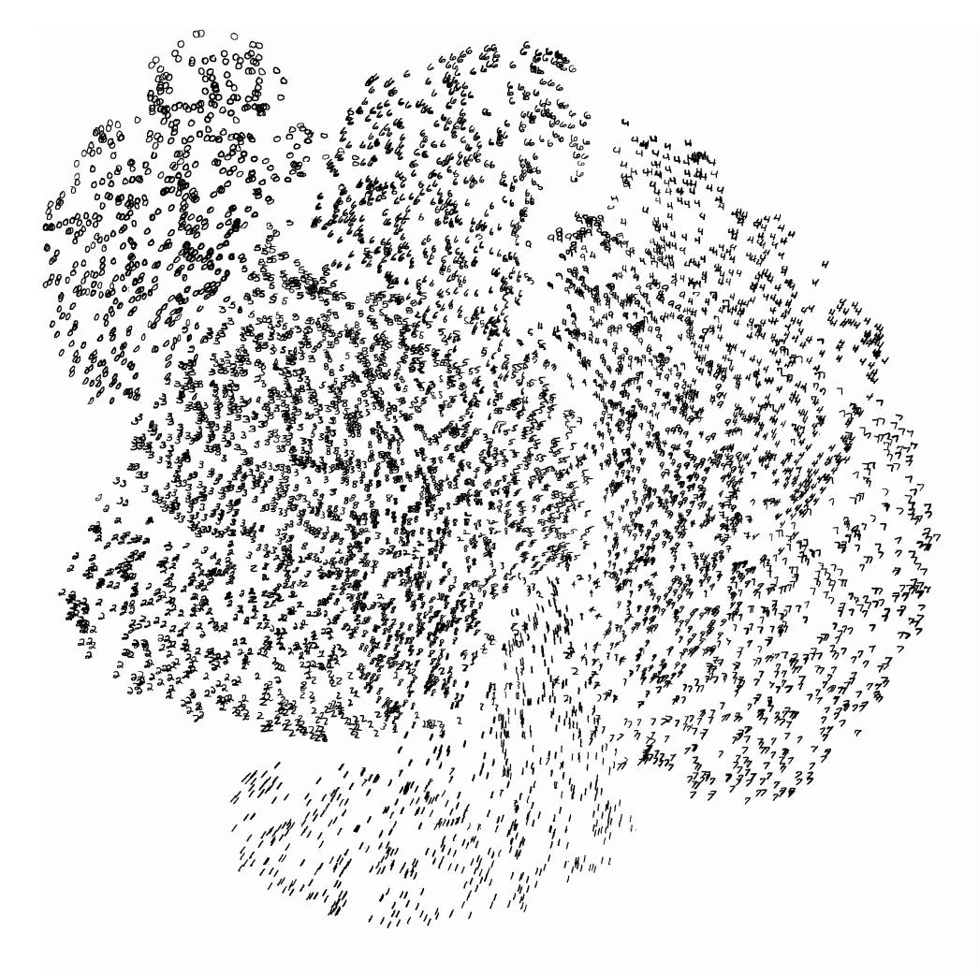
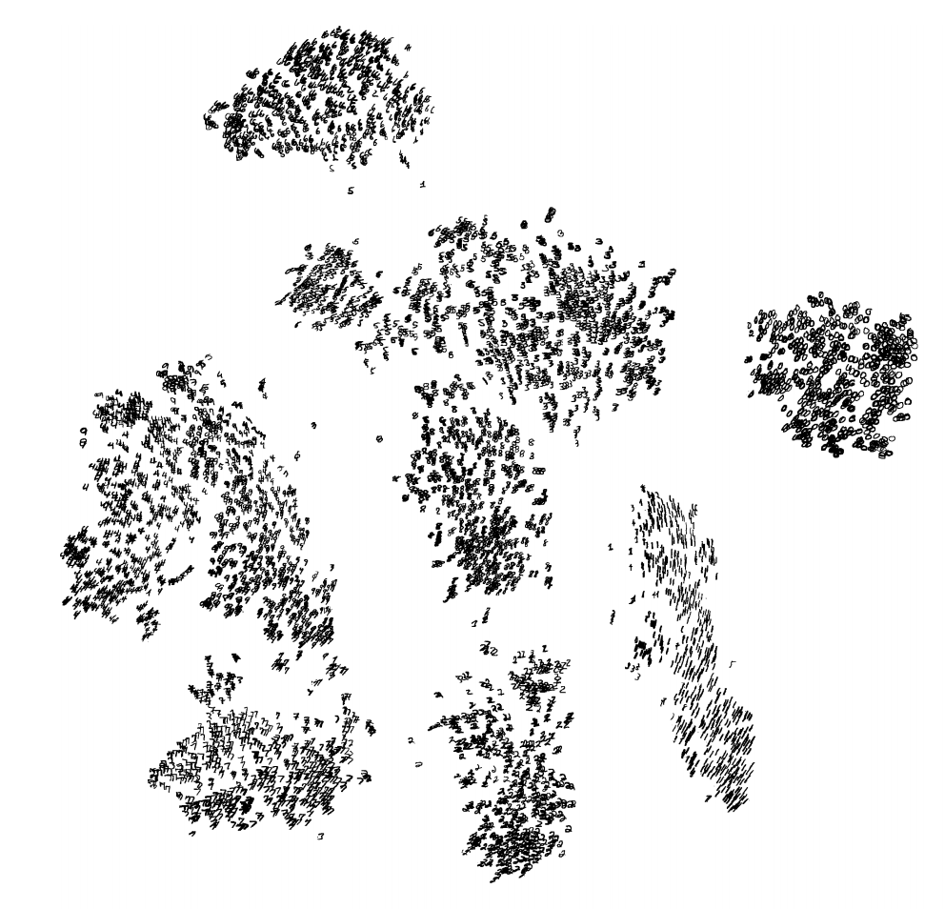
Performance on Data (MNIST)
SNE
t-SNE
Figure 3: Clusters of MNIST Images by SNE (https://lvdmaaten.github.io/publications/misc/Supplement_JMLR_2008.pdf )
Figure 4: Clusters of MNIST Images by t-SNE (https://lvdmaaten.github.io/publications/misc/Supplement_JMLR_2008.pdf )
Notes:
MNIST data set is a large number of images of handwritten digits.
Each of the images (gray scale) are composed of 764 pixels (28 by 28). Therefore we can think of each image as a data point in R^784.

Slide 11
Pitfalls
Variability of results due to random initial mapping
Focus on local structure hurts performance on data with high intrinsic dimensionality
For d >> 3, heavy tails on Student-t may hinder preservation of local structure

